Slide 1
Team Ink3D Status 11/14/13
Daniel Lain
Tim Edmonson
Shawn Simonson
Jesse Bowles

Slide 2
SRS Feedback to Address
Provide examples of objects the printer might create
Sparsity & Density Control not clearly explained
Ensure that non-critical and feature requirements are accounted for in design
Performance Consideration: Model Complexity, Processing Time
Use Cases feels incomplete
Feasibility assumptions regarding LoC Production

Slide 3
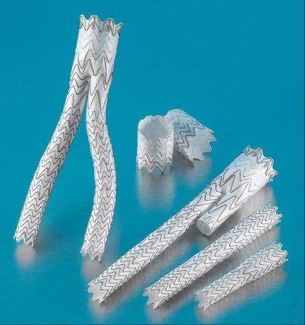
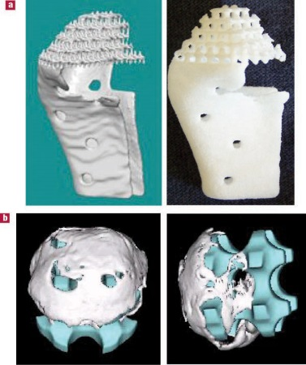
Feedback Resolution
Feedback: Provide examples of objects the printer might create
Bone grafts, tissue scaffolding, stents, etc.

Slide 4
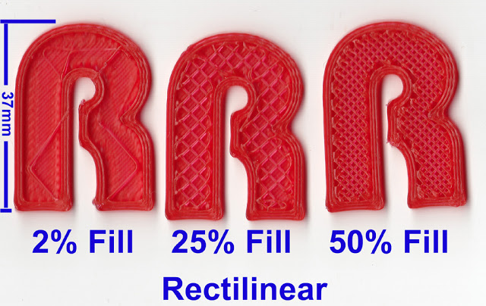
Feedback Resolution
Feedback: Sparsity & Density Control not clearly explained
Renaming Requirement: “Fill Density”
Option to conserve material
http://richrap.blogspot.com/2012/01/slic3r-is-nicer-part-1-settings-and.html

Slide 5
Feedback Resolution
Feedback: Ensure that non-critical and feature requirements are accounted for in design
Changes to Req. 8.3: “Modular and Scalable Design”
Performance Consideration: Model Complexity, Processing Time
Now addressed in Req. 5.3: “Object Processing Time”
Model must be closed & complete

Slide 6
Feedback Resolution
Use Cases Feel Incomplete
Added new case: “Edit Printer Configuration”
Feasibility assumptions regarding LoC Production
Familiar with Tools
Interface largely Java
Processing in C
Multiple years experience for team members

Slide 7
Other Issues
How does system recognize materials?
User selects material for each part
Software tells printer
What is actually in the database?
Diameter of the material filament
Temperature filament extrudes at
Extrusion speed
UV curing flag

Slide 8
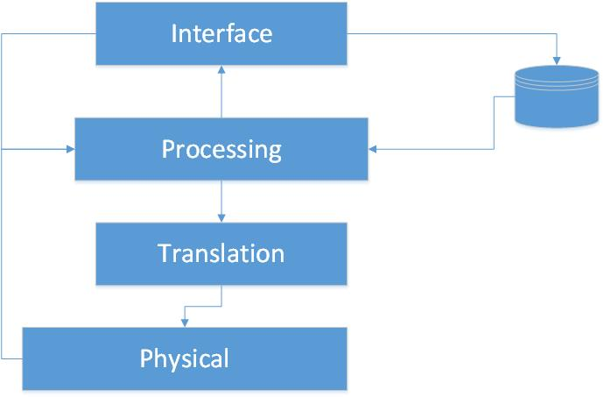
Next Step: Architecture

